Slide 1
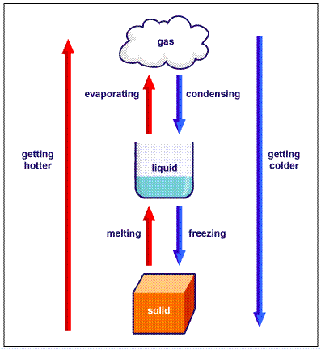
Chapter 7.1
States of Matter

Slide 2
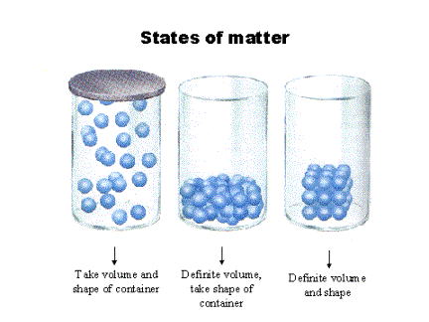
Matter
Anything that has mass and volume
The quantity of matter that a substance or object contains, the more matter the greater the mass
Measured in grams (g) or kilograms (kg)

Slide 3
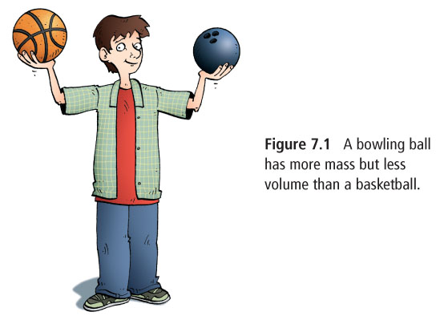
Volume
Amount of space taken up by a substance
Liquid measured in ml, L, or cm³

Slide 4
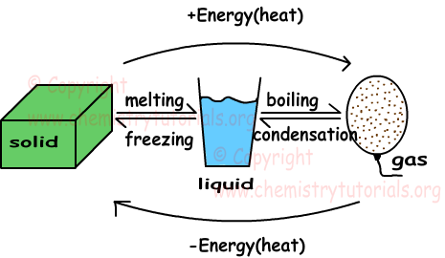
States or Phases of Matter:
Solid – definite shape and volume
Liquid – definite volume but shape is determined by container
Gas – volume and shape are determined by their surroundings

Slide 5
The Particle Model of Matter
All matter is made up of very small particles. (atoms)
There are spaces between the particles
the particles that make up matter are always moving
the particles are attracted to each other, strength of attraction depends on type of particle

Slide 6
The Kinetic Molecular Theory
Kinetic energy is the energy of motion
Particles in solids, liquids and gasses are always in motion
1. All matter is made up of very small particles (atoms and molecules)
2. There is empty space between particles
3. Particles are constantly moving, colliding with each other and the walls of the container
Solids – particles only vibrate
Liquids – particles can slide past each other
Gasses – far apart and move around quickly
4. Energy makes particles move. More energy = faster movement

Slide 8
Thermal Expansion and Contraction
To add energy we can add heat
When we add heat the particles move faster
The material expands and increases in volume = thermal expansion
The opposite happens when a material cools = thermal contraction
Each material expands or contracts at a unique rate
Examples include: thermometer, car coolant containers, bridges

Slide 9
The Difference Between Heat and Temperature
When two substances with different thermal energy come into contact, energy will flow from high to low thermal energy
Heat = the energy transferred from one material to another
Temperature = reading of a substance’s average kinetic energy

Slide 10
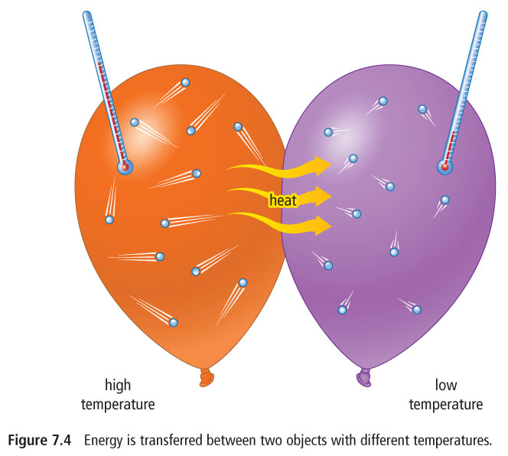

Slide 11
Changes of State
When temperature changes so can the state of the material:
Melting = solid to a liquid
Evaporation = liquid to a gas
Condensation = gas to a liquid
Solidification = liquid to a solid
Sublimation = solid directly to a gas (dry ice)
Deposition = gas directly to a solid (frost)

Slide 12
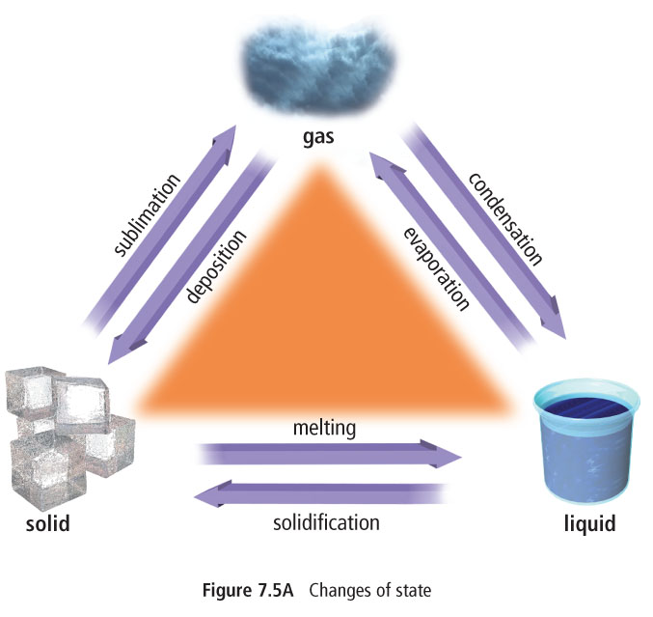

Slide 13
All substances have different specific temperatures at which they change state.
Melting point = temp. when a solid goes to a liquid
Boiling point = temp. when a liquid goes to a gas

Slide 14
HOMEWORK
Textbook Questions
P. 259 # 2, 3, 4, 5, 8, 9 and 10

