Slide 1
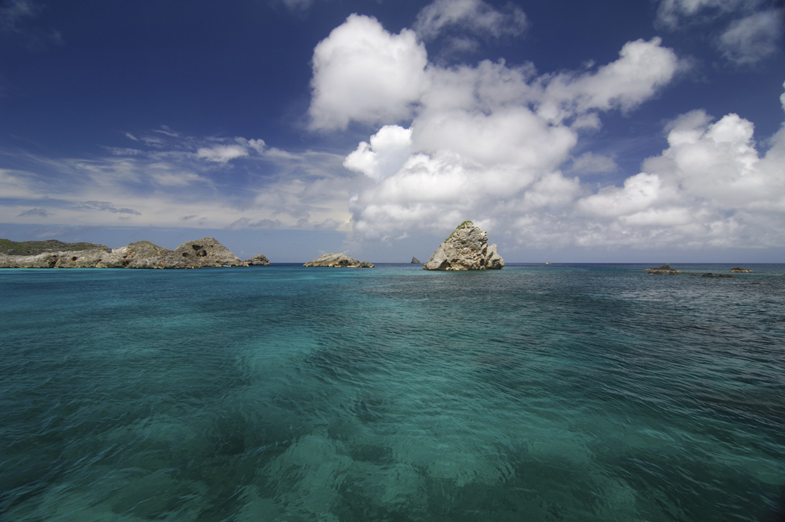
Ch. 11.1
Oceans Control the Water Cycle

Slide 2
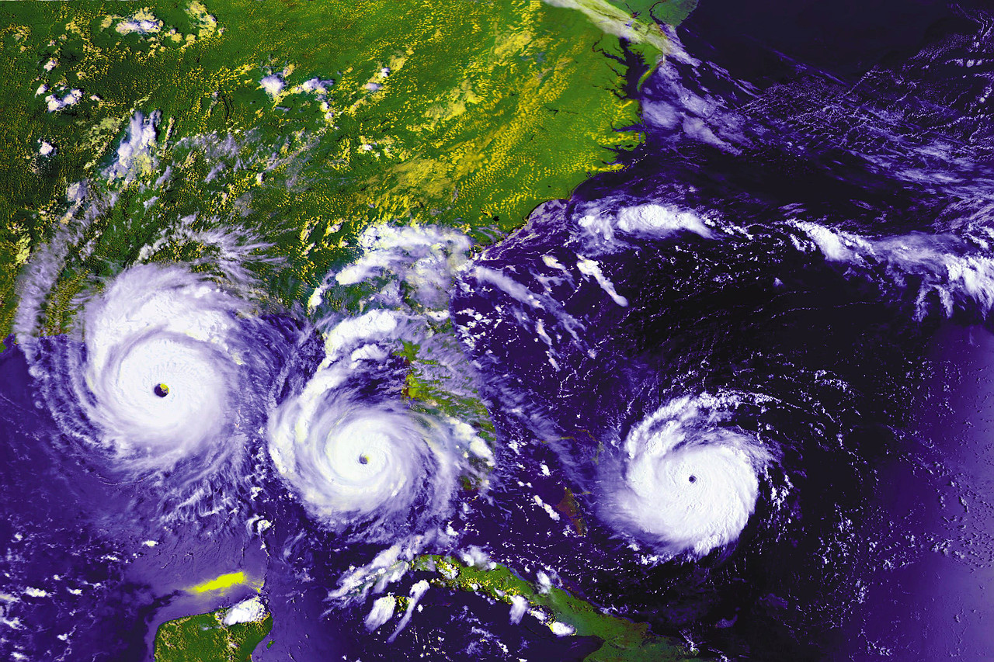
11.1 Ocean Basins
Oceans formed over 1.5 billion years from the runoff of the continents
2/3 earth’s surface covered by oceans
5 major oceans are:
Pacific, Atlantic, Indian, Antarctic (Southern), and Arctic
Basin- low points on the earth’s surface = oceans
Oceans make life possible, control temperatures, create weather patterns, source of water for precipitation.

Slide 3
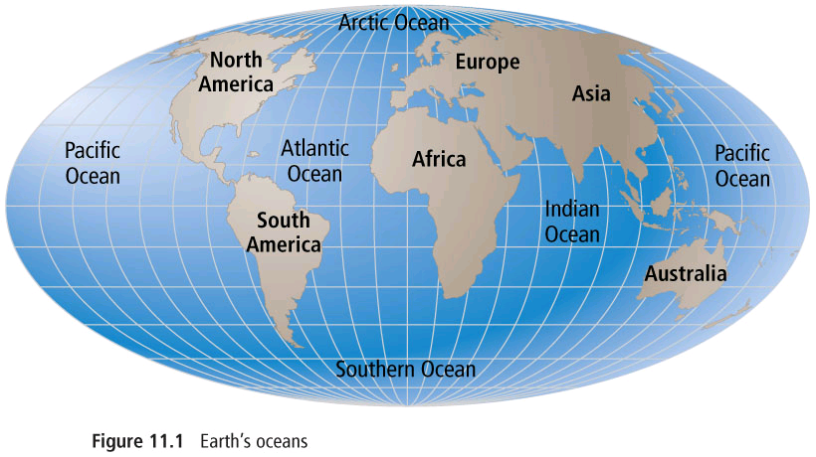
5 Main Oceans of the World

Slide 4
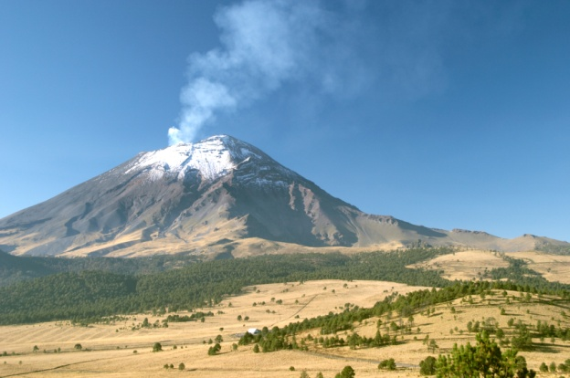
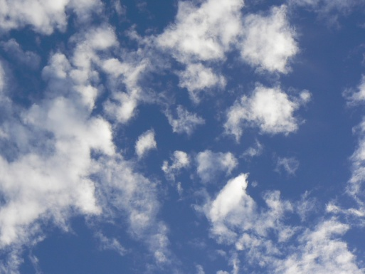
The Origin of Ocean Water
Planet formed 4.5 billion years ago ball of molten rock, started to cool but heat released from within, by volcanoes
Water vapour released into the atmosphere
Water from ice on comets coming to earth

Slide 5
Features of the Ocean Floor
Ocean floor is not flat but have many features like: mountain ranges, valleys, flat plains, canyons, and volcanoes
The features are larger than on land
Ocean floor has two distinct parts:
  Ocean basin- middle part
  Continental margins- edges

Slide 6
Ocean Basins
Forces change the ocean floor (storm water erodes coral reefs)
Greatest force = plate tectonics
  Solid rock plates floating over a molten layer
Two types of tectonic plates
  Oceanic- those that lie under the ocean- (more dense)
  Continental – those under continents

Slide 7
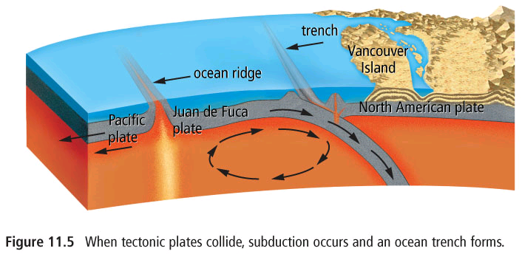
Continental and Ocean Plate Interactions

Slide 8
Plate Interactions
When plates are pushed apart magma rises to the surface = mid ocean ridge, the largest being the mid Atlantic Ridge
This ridge has been pushing Europe and America apart
Move 2.5 cm per year
Plates also move toward each other = subduction
  Ocean plate-ocean plate – mid ocean ridge- move apart
  Ocean- continent = ocean under continent = trench formed and mountains (volcanic)
  Continent – continent – mountains formed in the middle of the continent
Area between trenches and mid-ocean ridges = abyssal plains
Occasional peak = sea mount = inactive volcano

Slide 9
Continental Margins
Made up of the continental shelf and the continental slope
    Shelf = flat area that extends from the shoreline
    Slope = steep area that drops off to the ocean floor
    Rise = where sediments have been deposited at the end of a submarine canyon
    Abyssal plains- flat part extending from margin

Slide 10
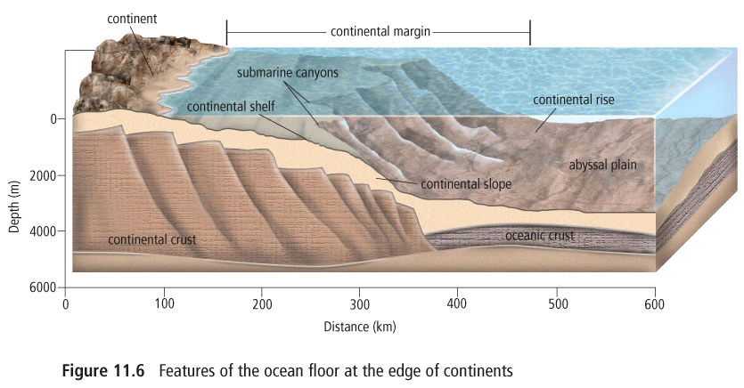
Features of Continental Margins

Slide 11
Continental Margins- cont.
Sediments are carried to the ocean in rivers and streams and build up on the slope, when they become too great the slope collapses creating a turbidity current = underwater landslide
Turbidity currents create the gentle slope of the continental rise
Some currents are so powerful they carve out submarine canyons
Sediments are also created from the remains of living animals

Slide 12
Your Assignment
Textbook Questions
P. 413 Questions #1-8 and #12
Workbook pages
Quiz next class

