Slide 1
CHAPTER 9
Series and Parallel Circuits

Slide 2
After this chapter, you should be able to…
Differentiate between series and parallel circuits in terms of their current, voltage and resistance
Define electrical energy and power.
Calculate power using voltage and current
Determine energy consumption given the power rating of a device and its duration of use (time it is used)

Slide 3
What do the following devices do? How do they do it?
Flashlight
Smoke Detector
Hair Dryer
Electric Motor
TV Remote
Microwave

Slide 4
What do the following devices do?
Flashlight → makes light
Smoke Detector → makes sound
Hair Dryer → makes heat
Electric Motor → makes movement
TV Remote → makes IR signals
Microwave → heats food

Slide 5
Why did I ask this?
Electricity is used by all of the devices we just listed to preform a specific function
This chapter will teach us how this is done.

Slide 6
Chapter 9.1 – Series and Parallel Circuits
There are two types of circuits used in electronics: series and parallel.
Define series circuit:
A series circuit is a circuit where electrons have only one possible path to travel.

Slide 7
In a series circuit the total voltage is equal to the sum of the voltages lost at each load. This is because each load uses some of the voltage to power itself.
Most electrons flowing in a circuit remain evenly spread apart. In a series circuit, the current in each part of the series (everywhere in the circuit) is equal.

Slide 8
What happens when resistors are added to a series circuit?
When resistors are added in series, the total resistance of the circuit increases, which decreases the total current through the whole circuit.

Slide 9
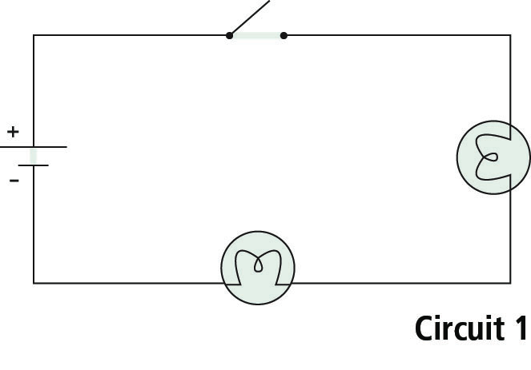
A simple series circuit.
These are the circuits we have been drawing so far. Notice how everything is connected in a chain (series).

Slide 10
Parallel Circuits
Define parallel circuit.
A parallel circuit has a minimum of two different pathways for electrons to travel through.

Slide 11
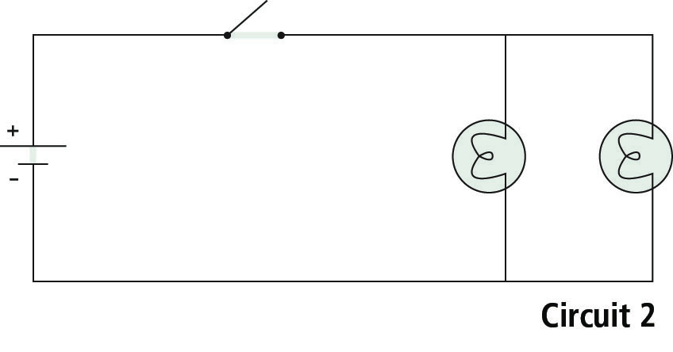
A parallel circuit.

Slide 12
When loads are placed in parallel, the voltage across each load remains constant. That is, each load will be supplied with the same voltage.
In a parallel circuit, the total current entering a junction must equal the sum of the current leaving the junction point. A pathway with less resistance will be able to have more electrons travel on it and therefore will have a greater current than the pathway with more resistance.

Slide 13
Question
If there is a resistor in a parallel circuit, and you add another one, what happens to the total resistance of the circuit?
It decreases! Why?
Think about it like a grocery store checkout.

