Slide 1
Section 7.2 – The Electric Force
Science 9

Slide 2
The Electric Force
Force
A push or a pull on one object caused by another
Electric Force
A push or a pull between charged objects

Slide 3
Contact versus At-a-distance forces
Contact forces: An object physically contacts another
E.g. Your snow shovel physically pushes snow out of the way
At-a-distance forces: AN object is pushed or pulled without being touched
E.g. Gravity pulls objects towards the Earth.

Slide 4
Contact Forces
At-a-distance forces
Friction
Air Resistance
Tension
Gravity
Magnetism
Electric force

Slide 5
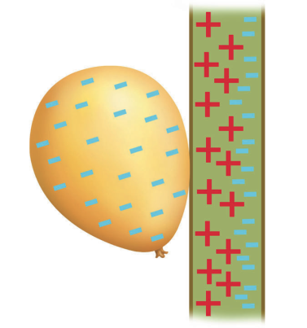
3 Laws of Static Charge
Opposite charges attract
Like charges repel
Charged objects attract neutral objects to them

Slide 6
The electric force is proportional to the charge! If you increase the charge, you increase the electric force (and vice versa).
If you increase the distance between charged objects, the electric force between them decreases.

Slide 7
Charging by CONDUCTION
Charging a neutral object by transferring electrons to or from the object by physically touching it!
Is permanent (until discharged by physically touching the object)

Slide 8
Charging by INDUCTION
Occurs when you bring a charged object near a neutral object. NO ELECTRONS ARE TRANSFERRED. Instead, the electrons in the neutral object rearrange themselves to stabilize the neutral object.

